Slide 1

HOISTING, DATA TYPES AND SCOPE
</>
HOISTING, DATA TYPES, SCOPE, CLOSURES, NUMBERS and MATH,

Slide 2
Redirection
URL redirection also known as URL forwarding is a technique to load another page using a URL and moves user from previous URL to a new one.
Redirections in JavaScript are performed by setting a URL string to the window.location property, loading the new page.
Redirection in JS
window.location = "https://google.com";
We can redirect a user when a specific event is fired using JS redirection.
Redirection in JS
btn.addEventListener("click", function() {
window.location = "https://google.com";
});

Slide 3
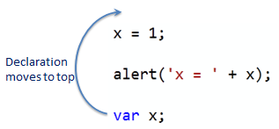
Hoisting
In other programming languages, variables or functions must be declared before using it.
In JavaScript, variable and function names can be used before declaring it. The JavaScript compiler moves all the declarations of variables and functions at the top so that there will not be any error. This is called hoisting.
If a developer doesn't understand hoisting, programs may contain bugs (errors).
To avoid bugs, always declare all variables at the beginning of every scope.
The above snippet will work the same as if we first declare the variable and then use it below, because JavaScript moves all declarations to the top.

Slide 4
Date & Time
JavaScript Date objects represent a single moment in time in a platform-independent format.
To store current date and time in a variable, we need to create an instance of Date object as:
Date & Time in JS
var d = new Date();
After creating an instance of Date object, we can then use different methods of that instance.
toISOString() converts a date to a string following the ISO 8601 Extended Format.
toUTCString() converts a date to a string using the UTC time-zone.
toTimeString() returns the "time" portion of the Date as a human-readable string.
There are a lot more methods like these that we can use on Date instance.

Slide 5
Time Functions
The global setTimeout() method sets a timer which executes a function or specified piece of code once the timer expires.
It takes a function as first argument and time duration (in milliseconds) as second argument.
Date & Time in JS
setTimeout(function() {
console.log("I will print after two seconds, Insha'Allah!");
}, 2000);
The setInterval() method, offered on the Window and Worker interfaces, repeatedly calls a function or executes a code snippet, with a fixed time delay between each call.

Slide 6
Data Types
The latest ECMAScript standard defines eight data types: seven of which are primitives, and eighth is Object.
Seven data types that are primitives are:
Boolean. true and false.
null. A special keyword denoting a null value. (Because JavaScript is case-sensitive, null is not the same as Null, NULL, or any other variant.)
undefined. A top-level property whose value is not defined.
Number. An integer or floating point number. For example: 42 or 3.14159.
BigInt. An integer with arbitrary precision. For example: 9007199254740992n.
String. A sequence of characters that represent a text value. For example: "Howdy"
Symbol (new in ECMAScript 2015). A data type whose instances are unique and immutable.
And Object.

Slide 7
Data Types
Boolean:
Boolean is a logical data type that can have only the values true or false.
null:
null value represents a reference that points, generally intentionally, to a nonexistent or invalid object
undefined:
undefined is a primitive value automatically assigned to variables that have just been declared, or to formal arguments for which there are no actual arguments.
Number:
Number is a numeric data type in the double-precision 64-bit floating point format (IEEE 754). In other programming languages different numeric types exist; for example, Integers, Floats, Doubles, or Bignums.

Slide 8
Data Types
BigInt:
BigInt is a numeric data type that can represent integers in the arbitrary precision format.
string:
a string is a sequence of characters used to represent text.
Object:
A collection of key-value pairs. A key can take any value like objects, functions, strings, etc.
To check the type of any thing in JavaScript, typeof keyword is used.
Objects and functions are the other fundamental elements in the language.

Slide 9
Scope
Scope determines the accessibility (visibility) of variables. JavaScript has 3 types of scope:
Global Scope
Function Scope
Block Scope
Global Scope:
Variables declared Globally (outside any function) have Global Scope.
Global variables can be accessed from anywhere in a JavaScript program.
Variables declared with var, let and const are quite similar when declared outside a block. They all have Global scope then.
Function Scope:
JavaScript has function scope: Each function creates a new scope..
Variables defined inside a function are not accessible (visible) from outside the function.
Variables declared with var, let and const are quite similar when declared inside a function.. They all have Function scope then.

Slide 10
Scope
Block Scope:
Before ES6 (2015), JavaScript had only Global Scope and Function Scope.
ES6 introduced two important new JavaScript keywords: let and const.
These two keywords provide Block Scope in JavaScript, means if they are defined inside any block, they are not accessible outside. For example, if var x is defined inside IF statement, it can be used outside but let and const cannot be used.
let and const variables declared inside a { } block cannot be accessed from outside the block.

Slide 11
Closures
Closures are one of the most powerful features of JavaScript.
JavaScript allows for the nesting of functions and grants the inner function full access to all the variables and functions defined inside the outer function (and all other variables and functions that the outer function has access to).
This nested function which has access to the outer scope is called closure.
However, the outer function does not have access to the variables and functions defined inside the inner function. This provides a sort of encapsulation for the variables of the inner function.
let and const variables declared inside a { } block cannot be accessed from outside the block.
Closures in JS
function init() {
var name = 'Mozilla'; // name is a local variable created by init
function displayName() { // displayName() is the inner function, a closure
alert(name); // use variable declared in the parent function
}
displayName();
}
init();

Slide 12
Numbers
Unlike many other programming languages, JavaScript does not define different types of numbers, like integers, short, long, floating-point etc.
All types of numbers like int, float, exponential, etc. are allowed in JavaScript.
NaN:
NaN is a JavaScript reserved word indicating that a number is not a legal number.
Converting Variables to Numbers:
There are 3 JavaScript methods that can be used to convert variables to numbers:
The Number() method
The parseInt() method
The parseFloat() method.

Slide 13
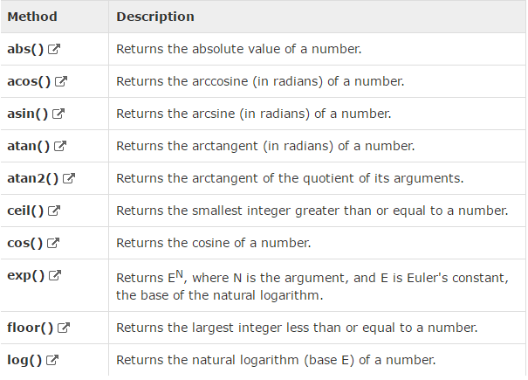
Math
The Math object provides you properties and methods for mathematical operations..
To use different properties of Math, we can call it directly without creating an instance of Math object.
Math in JS
Math.round(6.5);
Math.sqrt(36);
Math.random();

Slide 14

Any Questions?
THANKS!
Instructor: Umair Syed
Instructor 2: Farrukh Adeel
itsumairsyed@gmail.com
m.farrukhadeel@gmail.com
+92 309 0403499
+92 313 6732243
Quantum Learning Academy

